Slide 1

Simple MIPS Processor Simulation
Diego Lopez

Slide 2
Language and Location
Built with C++
Built in the x86 processor architecture system (Brooks)
More familiar and experienced with it

Slide 3
Overview of the simulator
A MIPS 5-stage pipeline simulator that models how a CPU would execute an assembly program cycle by cycle.
At the end of the simulation, it outputs the final state of the registers and memory
Goes through the 5 pipeline stages:
  Instruction Fetch (IF)
  Instruction Decode (ID)
  Execute (EX)
  Memory (MEM)
  Write Back (WB)

Slide 4
The files
Inst.h/Inst.cpp
Defines and implements instruction format and opcode set
parser.h/parser.cpp
Reads assembly text and converts it into Inst and Program objects
cpu.h/cpu.cpp
Defining and Implementing the pipeline simulator
util.h/util.cpp
Defines and implements Helper functions that support simulator
main.cpp
The entry point of the simulator or the “glue” of the simulator

Slide 5

The code

Slide 6
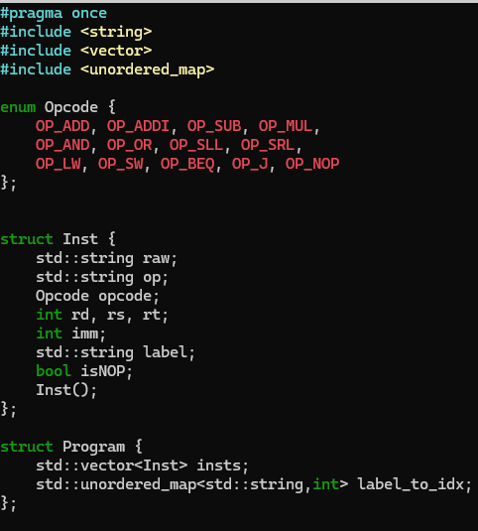
1. Inst header
Defines the blueprint of the instruction
What information each assembly must carry
Notable components:
Struct Inst: the representation of a single instruction.
Struct Program: container for assembly program after being parsed.
  Uses a vector for holding instructions
  Uses unordered map to label instruction positions
enum Opcode: Lists all instructions that the MIPS simulator can implement.
  Why enum? Have a cleaner and reliable way to represent instruction types

Slide 7
2. Parser header and cpp
Parser.h
Declares the parse_asm function that takes assembly code and makes a structured Program object
Parser.cpp
Implementation of the parse_asm function
  Reads each line of assembly
  Breaks into parts
  Converts into structured instructions
  Returns a Program object

Slide 8
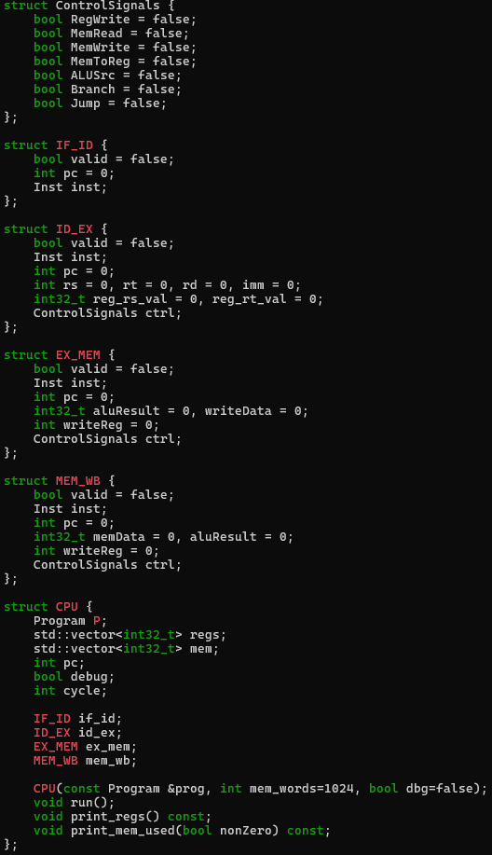
3. cpu.h
Defines CPU model for the simulator
Declares data structures and classes to represent pipeline stages, registers, memory, and control signals
Notable components:
Struct for Control signals
  Tells each stage what to do with the instruction
Structs for each pipeline register
Struct CPU: contains many CPU-related components
  Registers
  Memory
  Pc

Slide 9
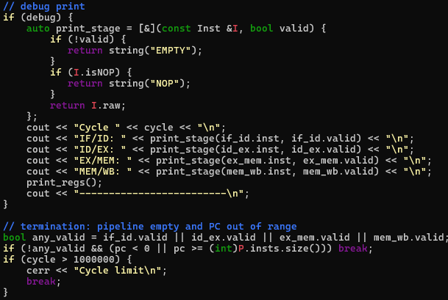
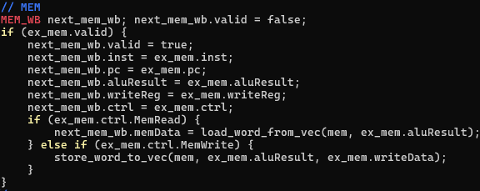
4. cpu.cpp
Implements the struct CPU defined in cpu.h
Notable Component:
void Cpu::run():
  Implements 5-stage pipeline
  Handles hazards by forwarding and stalling
  Updates the program counter when it encounters a branch
  Outputs the current cycle and what instruction is in each stage

Slide 10

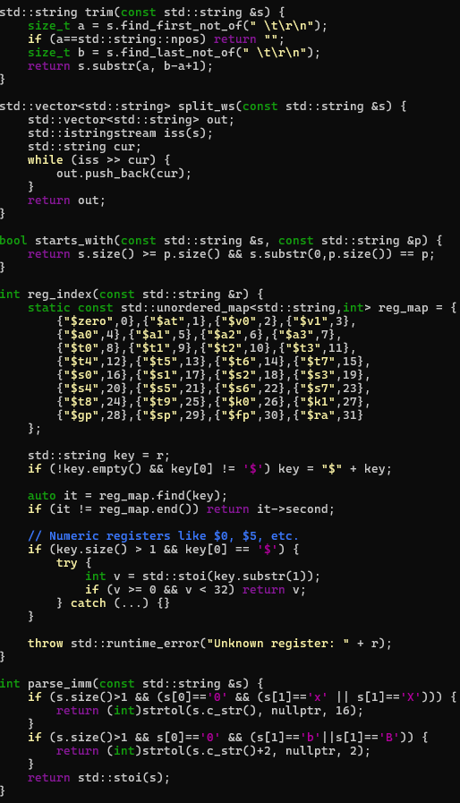
5. util header and cpp
Declares helper functions that support the simulator
Handles important tasks outside the main CPU logic
Makes the simulator cleaner and more modular
util.cpp implements the helper functions from util.h
Notable components:
reg_index: handles register name mapping
string_trim: removes any whitespace (helps the parser)
Parse_imm: converts a string immediate value to an integer

Slide 11
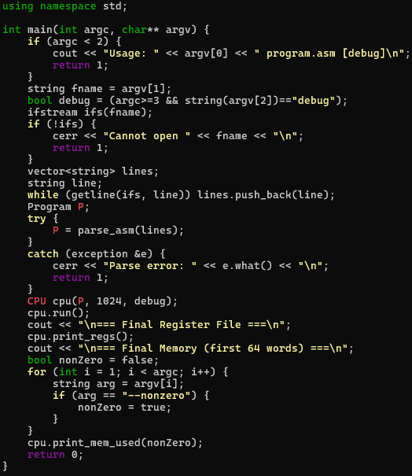
6. main.cpp
The entry point of the simulator
Ties the simulator together
Loads assembly program file
Calls the parser_asm function
Creates a CPU object
Runs the simulation
Prints the final state of registers and memory

Slide 12

MIPS Simulation demo

Slide 13

Questions?

